Slide 1

WALMART INC SALES DATA ANALYSIS.
By Ayomide Adeyemi

Slide 2
INTRODUCTION
Walmart is a multinational retail corporation that operates a chain of hypermarkets, discount department stores, and grocery stores. Walmart have few physical stores in Myanmar, but some of its products are available in the country through local merchants who import them from other countries. Walmart products are mainly sold in City Mart, a leading supermarket chain in Myanmar that operates in 20 cities and towns. Walmart’s presence in Myanmar is limited by several factors, such as the political and economic situation, the lack of infrastructure, the competition from other retailers, and the consumer preferences. Walmart has not

Slide 3
INTRODUCTION CONT’D
expressed any plans to dominate the Myanmar market, but it may consider doing so in the future if the conditions improve and the demand increases. Walmart operates in 20 other countries, including China, India, Japan, and Thailand.

Slide 4
Problem statement
The aim of this project is to explore Walmart sales data in order to understand the top performing product lines, branches, cities and as well as sales trend of different products and customer type behaviour. The aim is to study how sakes strategies can be improved and optimized. The following are the major problems to be analysed:
The top selling products and the least selling products.
The revenue made from each city.

Slide 5
PROBLEM STATEMENT CONT’D
The profit made from each city.
The revenue made from each month.
The total sales made from each month.
The customers type who patronise more.
The gender based revenue.
The revenue made from payment methods.

Slide 6
SKILL DEMONSTRATED
The following skillls are demonstrated :
Analytical skills.
Predictive skills.
Creative thinking.
Excel.
Data transformation.
Tableau for visualization.

Slide 7
DATA SOURCING
This data is sourced from www.Kaggle.com. Its is a csv file. It has 1000 rows and 17 columns. The data covered a three month period( Januar-March, 2019) of sales by Walmart Inc in Myanmar, Asia. The stores are located at three different cities in Myanmar, namely: Mandalay, Nay Pyi Taw, Yangon.

Slide 8
DATA TRANSFORMATION
This is a clean data. However, other columns were generated from the data like the cost of goods(COGS), which was the multiplication of unit price column by the quantity column. Also, the total revenue from sales was generated(Total Column) by adding COGS and Vat. Vat was included into COGS and passes to customers.

Slide 9
ANALYSIS AND VISUALIZATION
The Revenue for the period was $322,970.
The Total profit was $15,380.
The profit margin was 4.76%.
The total customers were 1,000.
The total of 5,510 items were sold.

Slide 10
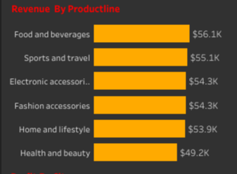
REVENUE BY PRODUCT
Food and beverages, Sports and travel, electronics were the top three revenue generating products as seen from the chart.

Slide 11
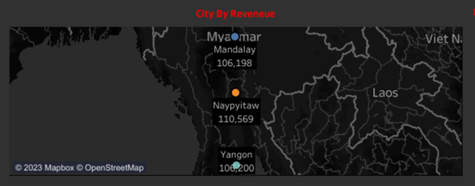
Revenue By City
Of the three cities with Walmart, Naypyidaw had the highest sales, followed by yangon and Mandalay respectively.

Slide 12
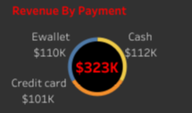
REVENUE BY PAYMENT
Customers paid by cash more than other mean of payment, followed by e-wallet and credit card respectively.

Slide 13
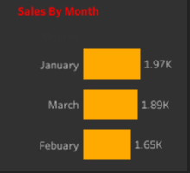
SALES BY MONTH
Highest products were sold in January and least in February.

Slide 14
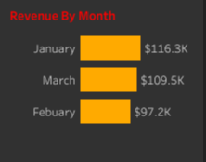
REVENUE BY MONTH
Consequently, January had the highest revenue, while February had the least revenue.

Slide 15
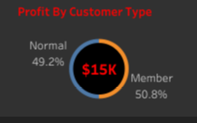
PROFIT BY CUSTOMER TYPE
“Member” customer type Marginally edge “Normal” customer type from from profit made from sales through them.

Slide 16
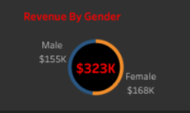
REVENUE BY GENDER
Sales to the female gender generated more revenue to the hypermarket than sales to the male gender.

Slide 17
CONCLUSION AND RECOMMENDATIONS
Conduct a detailed cost analysis to identify areas where costs can be reduced without compromising product quality or customer experience. Negotiate better deals with suppliers to lower the cost of goods sold (COGS). Optimize inventory management to reduce carrying costs.
Reevaluate your pricing strategy. Consider whether you can increase prices without losing a significant number of customers. Implement dynamic pricing if applicable. Offer bundled packages to increase the average order value.

Slide 18
CONCLUSION AND RECOMMENDATIONS CONT’D
Segment your customer base to identify high-value customers who are more profitable. Implement personalized marketing and product recommendations to increase customer retention and cross-selling.
Streamline your supply chain to reduce shipping and fulfillment costs. Explore options like dropshipping or outsourcing to lower operational expenses.
Invest in data analytics and business intelligence tools to gain deeper insights into customer behavior, sales trends, and cost

Slide 19
CONCLUSION AND RECOMMENDATIONS CONT’D
structures. Use data to make informed decisions about inventory, marketing, and product offerings.
Diversify your product range to attract new customer segments and increase cross-selling opportunities. Consider private-label products with higher profit margins
Focus on customer retention to reduce customer acquisition costs. Implement a loyalty program to incentivize repeat purchases.

Slide 20
CONCLUSION AND RECOMMENDATIONS CONT’D
Optimize your marketing campaigns to ensure a higher return on investment (ROI). Shift budget towards high-performing marketing channels and campaigns.
Review your advertising spend and allocate resources to digital advertising channels with a proven track record of generating sales Continuous Improvement:

Slide 21
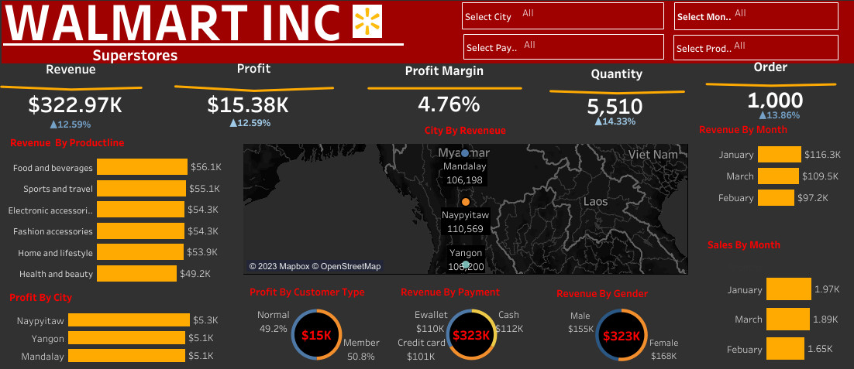

Slide 22
THANK YOU

